Slide 1

Is data science a good career?
Presented by: manuel Cervantes, Ankita Gautam, Stephen Lane, Lorena Martinez, Joel Navarro

Slide 2

Data & Clean up process
Kaggle
Glass door dataset
Time Period:
Department of Labor website
Multiple datasets
Time Period:

Slide 3
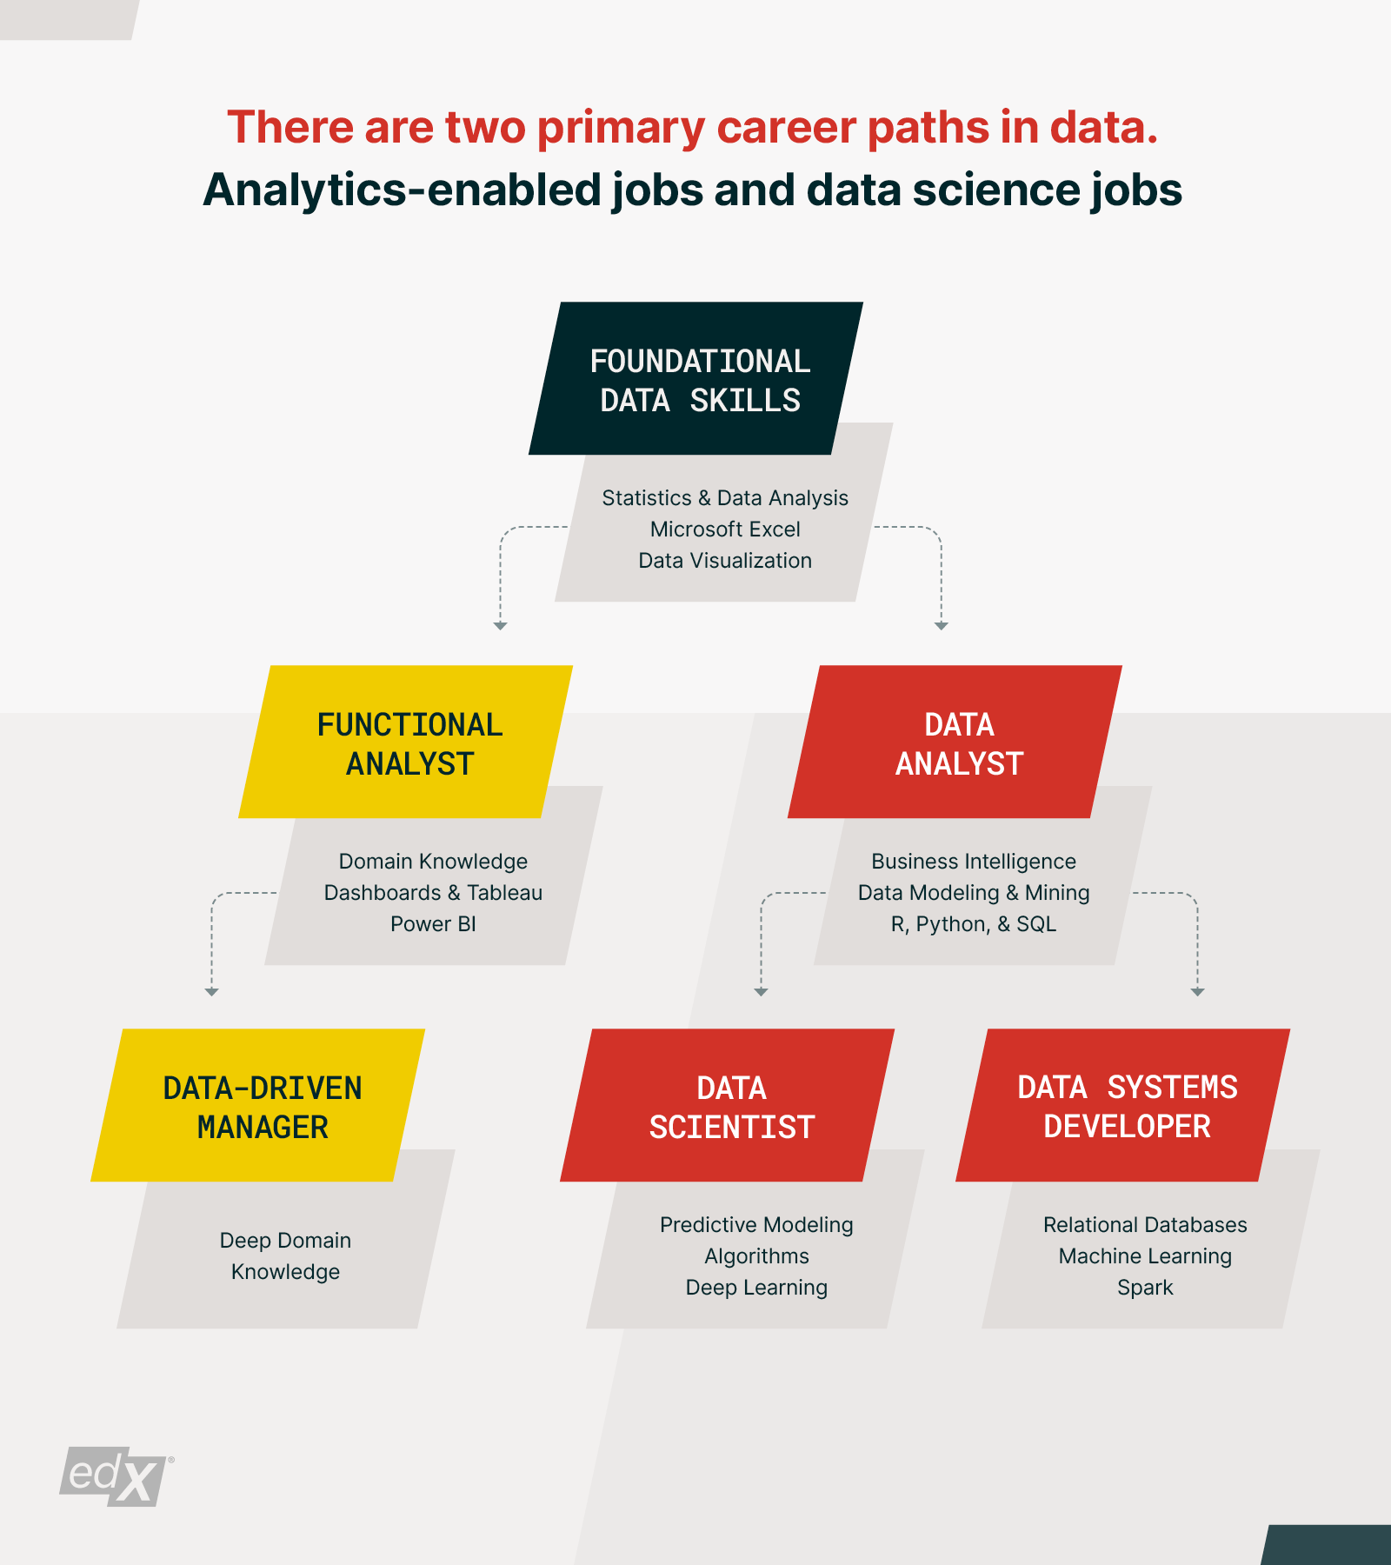

Slide 4
Typical education and experience (dol data)
Not a large demand to have prior experience in the industry
90% of all occupations required some sort of formal education, 60% of which required a Bachelor’s degree

Slide 5
How much Do they pay?

Slide 6
Who needs data scientists?
Top Industries Hiring Data Scientists

Slide 7
TOP 10 job titles on glass door
Job Title | #
Data Scientist | 274
Data Engineer | 260
Sr Data Scientist | 91
Machine Learning Engineer | 47
Sr Data Analyst | 47
Big Data Engineer | 41
Business Intelligence Analyst | 39
Sr Data Engineer | 37
Lead Data Scientist | 23

Slide 8
Where Are the Jobs?
City | Job Count
Austin, TX | 345
Chicago, IL | 330
San Diego, CA | 304
New York, NY | 303
Houston, TX | 219
Philadelphia, PA | 210
Los Angeles, CA | 206
Dallas, TX | 180
San Antonio, TX | 177
Phoenix, AZ | 165

Slide 9
Let’s look at Texas
Texas | Job Count
Austin, TX | 345
Houston, TX | 219
Dallas, TX | 180
San Antonio, TX | 177

Slide 10
Degrees & Certifications
Degree
Boot Camps
Certified Programs

Slide 11
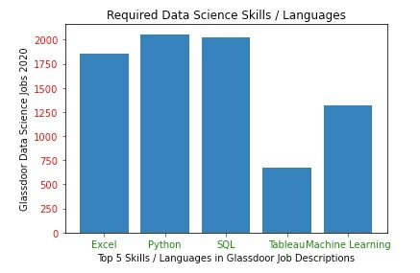
How do you become a Data Scientist?
Required Skills
Python
R
SQL
Scala
Julia
JavaScript
C/C++
Mat Lab
Excel
Machine Language
HTML
Swift
SAS

